Slide 1
高性能计算程序设计基础
任课教师：黄聃（Huang，Dan）

Slide 2
An Introduction to Parallel Programming
Peter Pacheco
Chapter 3
Distributed Memory Programming with
MPI

Slide 3
Roadmap
# Chapter Subtitle
Writing your first MPI program.
Using the common MPI functions.
The Trapezoidal Rule in MPI.
Collective communication.
MPI derived datatypes.
Performance evaluation of MPI programs.
Parallel sorting.
Safety in MPI programs.

Slide 4
A distributed memory system

Slide 5
A shared memory system

Slide 6
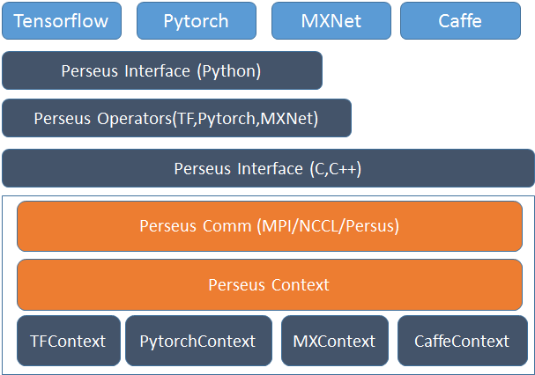
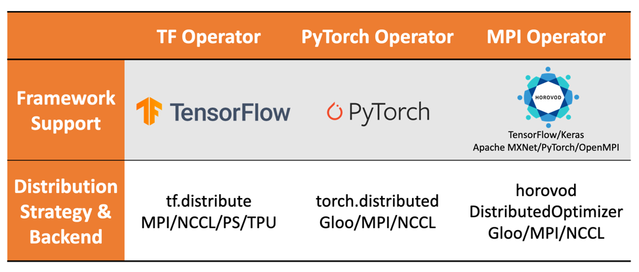

Slide 7
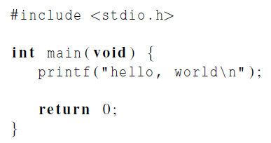

Hello World!
(a classic)

Slide 8
Finding Out About the Environment
Two important questions that arise early in a parallel program are:
How many processes are participating in this computation?
Which one am I?
MPI provides functions to answer these questions:
MPI_Comm_size reports the number of processes.
MPI_Comm_rank reports the rank, a number between 0 and size-1, identifying the calling process

Slide 9
Identifying MPI processes
Common practice to identify processes by nonnegative integer ranks.
p processes are numbered 0, 1, 2, .. p-1

Slide 10

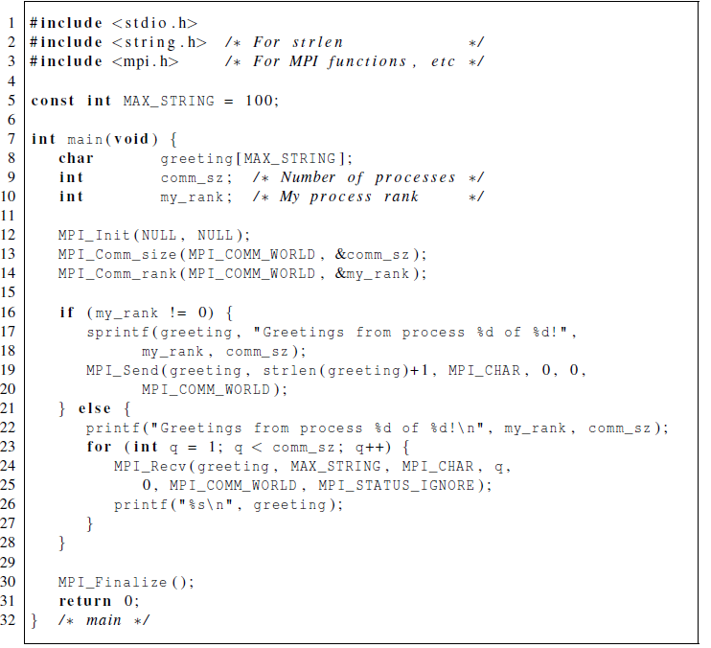
Our first MPI program

Slide 11
Set OpenMPI Path
Then add the following at
the end of your ~/.bashrc file and source it with the command
source ~/.bashrc (or log in again).
#----------------------------------------------------------------------
# OpenMPI setup
export PATH=/opt/OpenMPI/bin:$PATH
export MANPATH= =/opt/ OpenMPI/man :$MANPATH
export LD_LIBRARY_PATH=/opt/OpenMPI/lib:$LD_LIBRARY_PATH
#----------------------------------------------------------------------
Some logging and visulaization help:
You can Link with the libraries -llmpe -lmpe to enable logging and the MPE environment. Then run the program as usual and a log file will be produced. The log file can be visualized using the jumpshot program that comes bundled with MPICH2.
2.11

Slide 12
Compilation
wrapper script to compile
source file
mpicc -g -Wall -o mpi_hello mpi_hello.c
produce debugging
information
create this executable file name
(as opposed to default a.out)
turns on all warnings

Slide 13
Setup Multiple Computer Environment
Create a file called say “machines” containing the list of machines:
athena.cs.siu.edu oscarnode1.cs.siu.edu
………. oscarnode8.cs.siu.edu
Establish network environments
mpdboot –n 9 –f machines
mpdtrace
mpdallexit

Slide 14
Execution
mpiexec -n <number of processes> <executable>
mpiexec -n 1 ./mpi_hello
run with 1 process
mpiexec -n 4 ./mpi_hello
run with 4 processes

Slide 15
Execution
mpiexec -n 1 ./mpi_hello
Greetings from process 0 of 1 !
mpiexec -n 4 ./mpi_hello
Greetings from process 0 of 4 !
Greetings from process 1 of 4 !
Greetings from process 2 of 4 !
Greetings from process 3 of 4 !

Slide 16
MPI Programs
Written in C.
Has main.
Uses stdio.h, string.h, etc.
Need to add mpi.h header file.
Identifiers defined by MPI start with “MPI_”.
First letter following underscore is uppercase.
For function names and MPI-defined types.
Helps to avoid confusion.

Slide 17
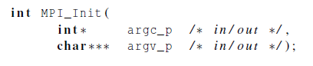
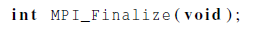
MPI Components
MPI_Init
Tells MPI to do all the necessary setup.
MPI_Finalize
Tells MPI we’re done, so clean up anything allocated for this program.

Slide 18
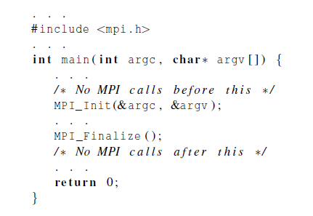
Basic Outline

Slide 19
Communicators
A collection of processes that can send messages to each other.
MPI_Init defines a communicator that consists of all the processes created when the program is started.
Called MPI_COMM_WORLD.

Slide 20

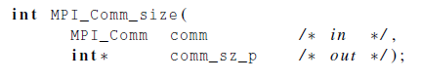
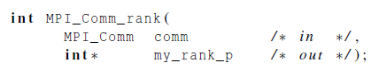
Communicators
number of processes in the communicator
my rank (the process making this call)

Slide 21
#include “mpi.h”
#include <stdio.h>
#include <math.h>
#define MAXSIZE 1000
void main(int argc, char *argv)
{
int myid, numprocs;
int data[MAXSIZE], i, x, low, high, myresult, result;
char fn[255];
char *fp;
MPI_Init(&argc, &argv);
MPI_Comm_size(MPI_COMM_WORLD,&numprocs);
MPI_Comm_rank(MPI_COMM_WORLD,&myid);
if (myid == 0) { /* Open input file and initialize data */
strcpy(fn,getenv(“HOME”));
strcat(fn,”/MPI/rand_data.txt”);
if ((fp = fopen(fn,”r”)) == NULL) {
printf(“Can’t open the input file: %s\n\n”, fn);
exit(1);
}
for(i = 0; i < MAXSIZE; i++) fscanf(fp,”%d”, &data[i]);
}
MPI_Bcast(data, MAXSIZE, MPI_INT, 0, MPI_COMM_WORLD); /* broadcast data */
x = n/nproc; /* Add my portion Of data */
low = myid * x;
high = low + x;
for(i = low; i < high; i++)
myresult += data[i];
printf(“I got %d from %d\n”, myresult, myid); /* Compute global sum */
MPI_Reduce(&myresult, &result, 1, MPI_INT, MPI_SUM, 0, MPI_COMM_WORLD);
if (myid == 0) printf(“The sum is %d.\n”, result);
MPI_Finalize();
}
Sample MPI program

Slide 22
SPMD
Single-Program Multiple-Data
We compile one program.
Process 0 does something different.
Receives messages and prints them while the other processes do the work.
The if-else construct makes our program SPMD.

Slide 23
MPI Basic Send/Receive
We need to fill in the details in
Things that need specifying:
How will “data” be described?
How will processes be identified?
How will the receiver recognize/screen messages?
What will it mean for these operations to complete?
Process 0
Process 1
Send(data)
Receive(data)

Slide 24
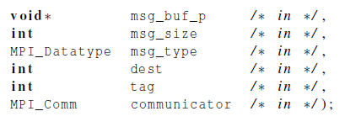

Communication

Slide 25
MPI Datatypes
The data in a message to send or receive is described by a triple (address, count, datatype), where
An MPI datatype is recursively defined as:
predefined, corresponding to a data type from the language (e.g., MPI_INT, MPI_DOUBLE)
a contiguous array of MPI datatypes
a strided block of datatypes
an indexed array of blocks of datatypes
an arbitrary structure of datatypes
There are MPI functions to construct custom datatypes, in particular ones for subarrays
May hurt performance if datatypes are complex

Slide 26
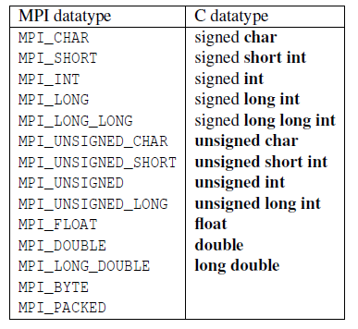
Data types

Slide 27
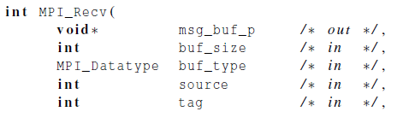
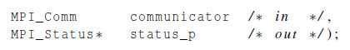
Communication

Slide 28
MPI Tags
Messages are sent with an accompanying user-defined integer tag, to assist the receiving process in identifying the message
Messages can be screened at the receiving end by specifying a specific tag, or not screened by specifying MPI_ANY_TAG as the tag in a receive
Some non-MPI message-passing systems have called tags “message types”. MPI calls them tags to avoid confusion with datatypes

Slide 29

Message matching
Count of data
r
MPI_Send
src = q
MPI_Recv
dest = r
q

Slide 30

Receiving messages
A receiver can get a message without knowing:
the amount of data in the message,
the sender of the message, ( MPI_ANY_SOURCE)
or the tag of the message. ( MPI_ANY_TAG)

Slide 31
status_p argument
How receiver finds out the sender, tag if they are not needed
by the receiver
Count of received data
MPI_Status*
MPI_Status* status;
status.MPI_SOURCE
status.MPI_TAG
MPI_SOURCE
MPI_TAG
MPI_ERROR

Slide 32
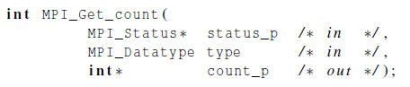

How much data am I receiving?

Slide 33
Issues with send and receive
Exact behavior is determined by the MPI implementation.
MPI_Send (locally blocking with buffer copied to internal storage or block starts transmission) may behave differently with regard to buffer size, cutoffs and blocking.
MPI_Recv always blocks until a matching message is received.
Non-blocking MPI_Isend and MPI_Irecv, immediate return.
Know your implementation; don’t make assumptions!

Slide 34

Trapezoidal rule in mpi 基于MPI的梯形积分法

Slide 35
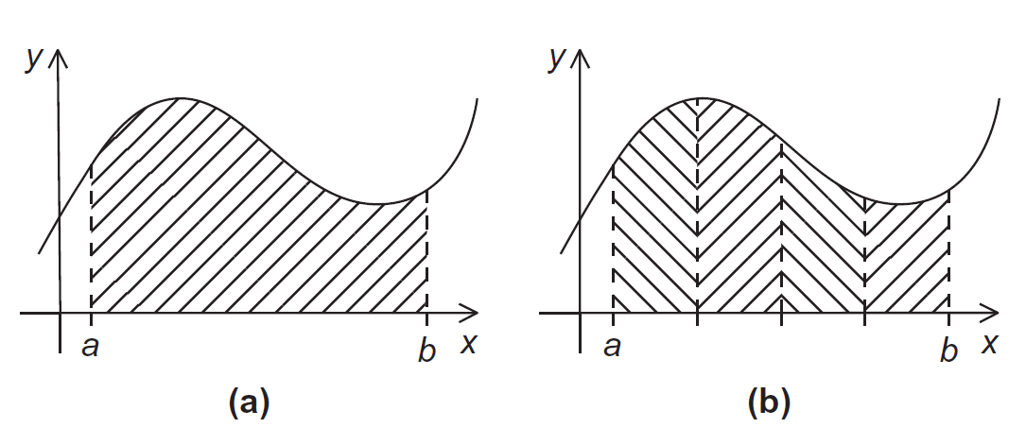
The Trapezoidal Rule

Slide 36
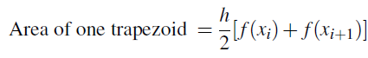
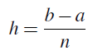
The Trapezoidal Rule（梯形积分法）

Slide 37
One trapezoid

Slide 38
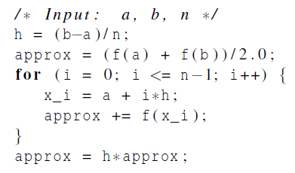
Pseudo-code for a serial program

Slide 39
Parallelizing the Trapezoidal Rule
Partition problem solution into tasks.
Identify communication channels between tasks.
Aggregate tasks into composite tasks.
Map composite tasks to cores.

Slide 40
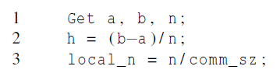
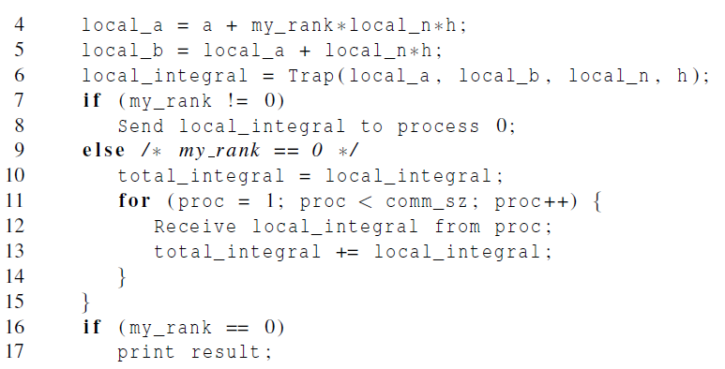
Parallel pseudo-code

Slide 41
Tasks and communications for Trapezoidal Rule

Slide 42
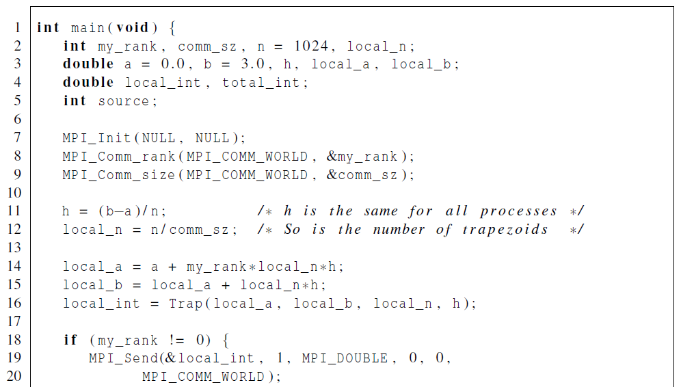
First version (1) 程序3-2

Slide 43
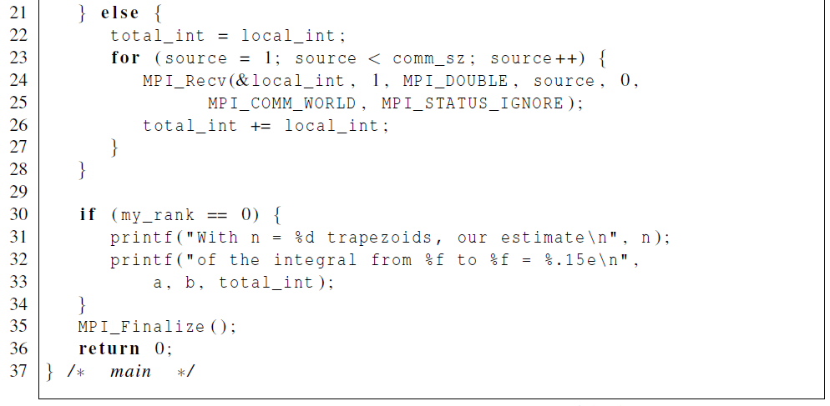
First version (2)

Slide 44
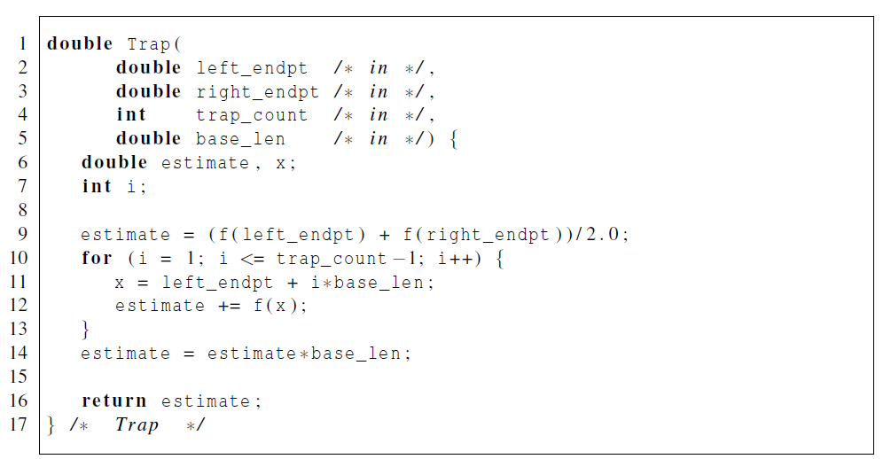
First version (3)

Slide 45
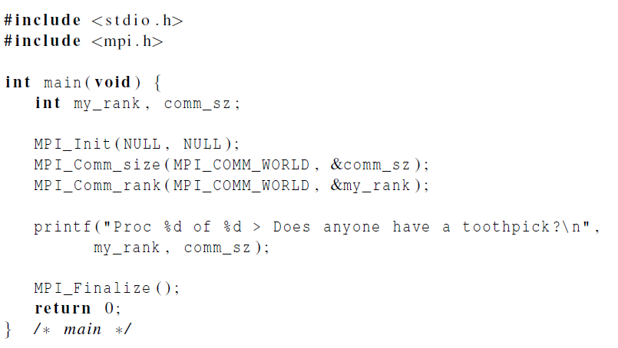
Dealing with I/O
Each process just prints a message.

Slide 46
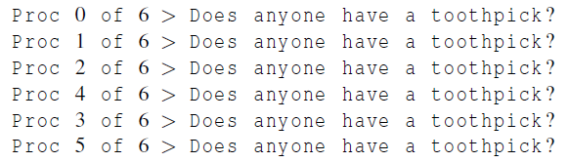
Running with 6 processes
unpredictable output

Slide 47
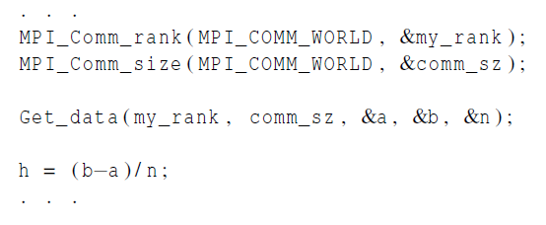
Input
Most MPI implementations only allow process 0 in MPI_COMM_WORLD access to stdin.
Process 0 must read the data (scanf) and send to the other processes.

Slide 48
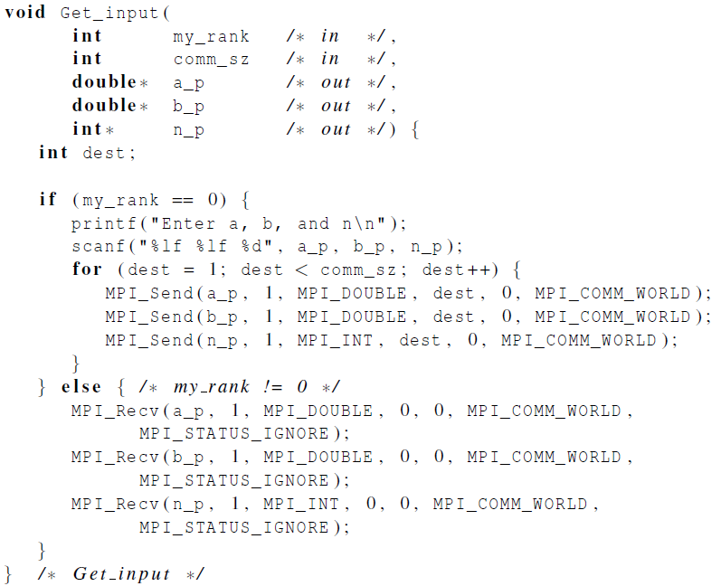
Function for reading user input

Slide 49

Collective communication

Slide 50
Tree-structured communication
In the first phase: (a) Process 1 sends to 0, 3 sends to 2, 5 sends to 4, and 7 sends to 6. (b) Processes 0, 2, 4, and 6 add in the received values. (c) Processes 2 and 6 send their new values to processes 0 and 4, respectively. (d) Processes 0 and 4 add the received values into their new values.
(a) Process 4 sends its newest value to process 0. (b) Process 0 adds the received value to its newest value.

Slide 51
A tree-structured global sum

Slide 52
An alternative tree-structured global sum

Slide 53
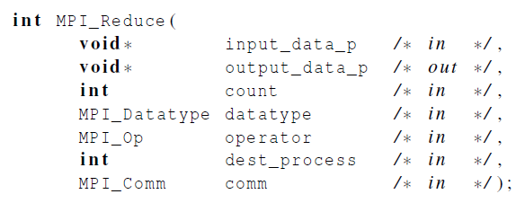
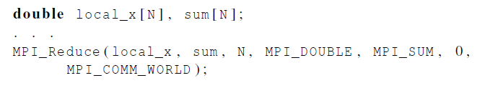
MPI_Reduce

Slide 54
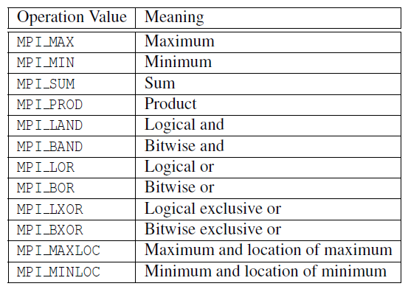
Predefined reduction operators in MPI

Slide 55
Collective Data Movement
P0
A
ABCD
P1
Reduce
B
P2
C
P3
D
P0
A
A
P1
B
AB
Scan
P2
C
ABC
P3
D
ABCD

Slide 56
Collective Data Movement
P0
A
A
P1
Broadcast
A
P2
A
P3
A
P0
A
B
C
D
Scatter
A
P1
B
P2
C
Gather
P3
D

Slide 57
Collective Data Movement
P0
A
A
B
C
D
P1
B
Allgather
A
B
C
D
P2
C
A
B
C
D
P3
D
A
B
C
D
P0
A0
A1
A2
A3
A0
B0
C0
D0
P1
B0
B1
B2
B3
A1
B1
C1
D1
P2
Alltoall
C0
C1
C2
C3
A2
B2
C2
D2
P3
D0
D1
D2
D3
A3
B3
C3
D3

Slide 58
Collective vs. Point-to-Point Communications
All the processes in the communicator must call the same collective function.
For example, a program that attempts to match a call to MPI_Reduce on one process with a call to MPI_Recv on another process is erroneous, and, in all likelihood, the program will hang or crash.

Slide 59
Collective vs. Point-to-Point Communications
The arguments passed by each process to an MPI collective communication must be “compatible.”
For example, if one process passes in 0 as the dest_process and another passes in 1, then the outcome of a call to MPI_Reduce is erroneous, and, once again, the program is likely to hang or crash.

Slide 60
Collective vs. Point-to-Point Communications
The output_data_p argument is only used on dest_process.
However, all of the processes still need to pass in an actual argument corresponding to output_data_p, even if it’s just NULL.

Slide 61
Collective vs. Point-to-Point Communications
Point-to-point communications are matched on the basis of tags and communicators.
Collective communications don’t use tags.
They’re matched solely on the basis of the communicator and the order in which they’re called (调用顺序）.

Slide 62
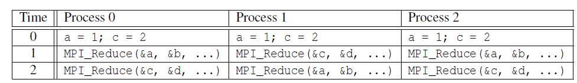
Example (1)
b = 4，d = 5
Multiple calls to MPI_Reduce,
Suppose that each process calls MPI_Reduce with operator MPI_SUM, and destination process 0.

Slide 63
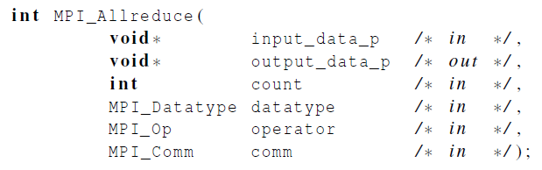
MPI_Allreduce
Useful in a situation in which all of the processes need the result of a global sum in order to complete some larger computation.

Slide 64
A global sum followed by distribution of the result.

Slide 65

A butterfly-structured global sum.

Slide 66
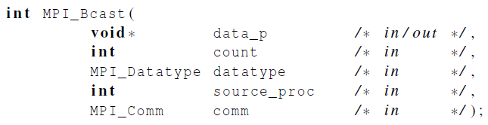
Broadcast
Data belonging to a single process is sent to all of the processes in the communicator.

Slide 67

A tree-structured broadcast.

Slide 68
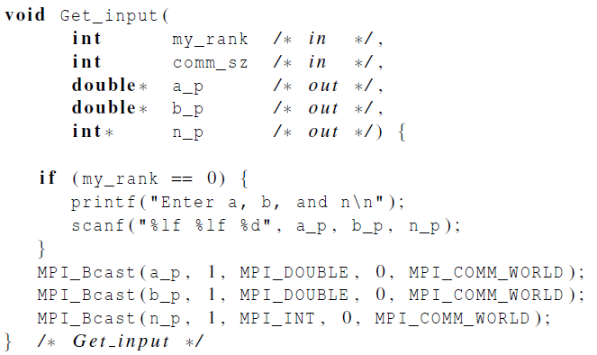
A version of Get_input that uses MPI_Bcast

Slide 69
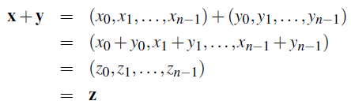
Data distributions
Compute a vector sum.

Slide 70
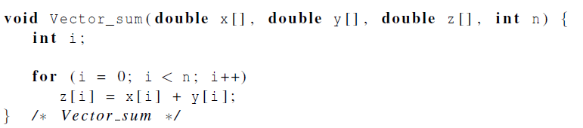
Serial implementation of vector addition

Slide 71
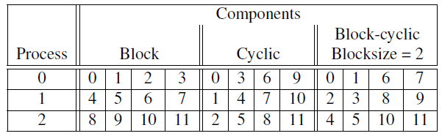
Different partitions of a 12-component vector among 3 processes

Slide 72
Partitioning options
Block partitioning
Assign blocks of consecutive components to each process.
Cyclic partitioning
Assign components in a round robin fashion.
Block-cyclic partitioning
Use a cyclic distribution of blocks of components.

Slide 73
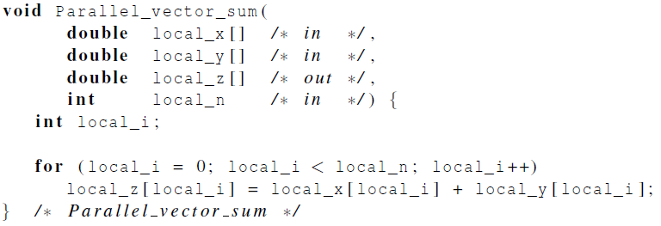
Parallel implementation of vector addition
伪代码

Slide 74
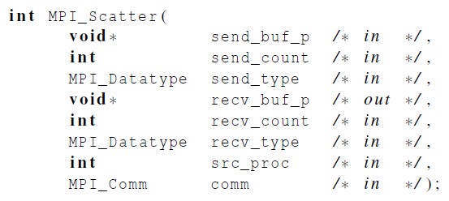
Scatter
MPI_Scatter can be used in a function that reads in an entire vector on process 0 but only sends the needed components to each of the other processes.

Slide 75
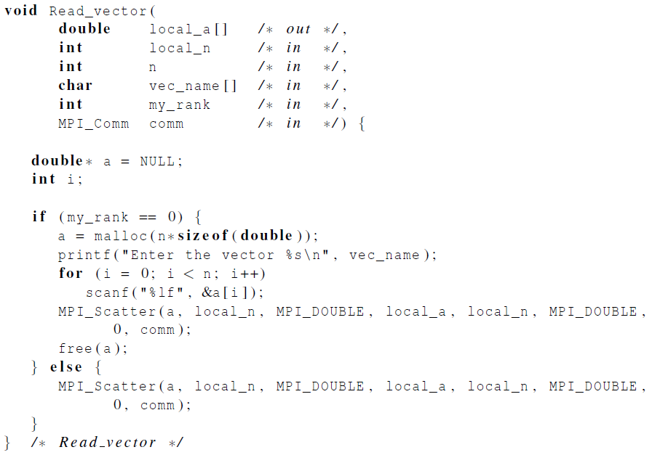
Reading and distributing a vector

Slide 76
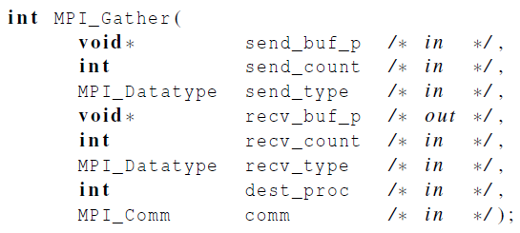
Gather
Collect all of the components of the vector onto process 0, and then process 0 can process all of the components.

Slide 77
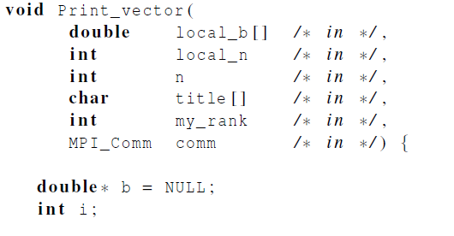
Print a distributed vector (1)

Slide 78
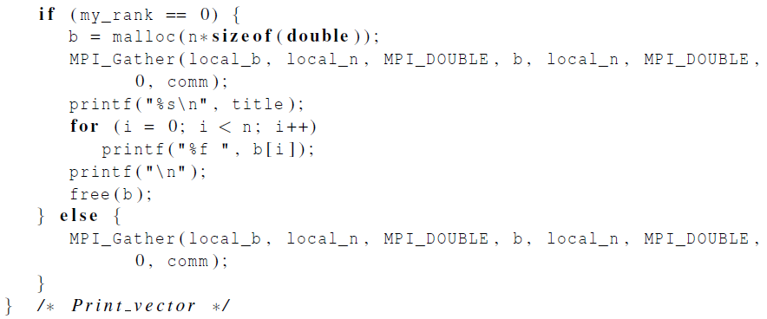
Print a distributed vector (2)

Slide 79
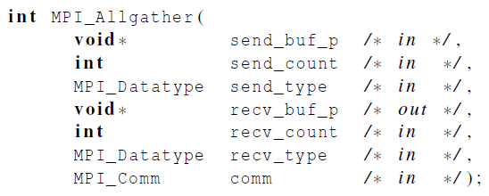
Allgather
Concatenates the contents of each process’ send_buf_p and stores this in each process’ recv_buf_p.
As usual, recv_count is the amount of data being received from each process.

Slide 80
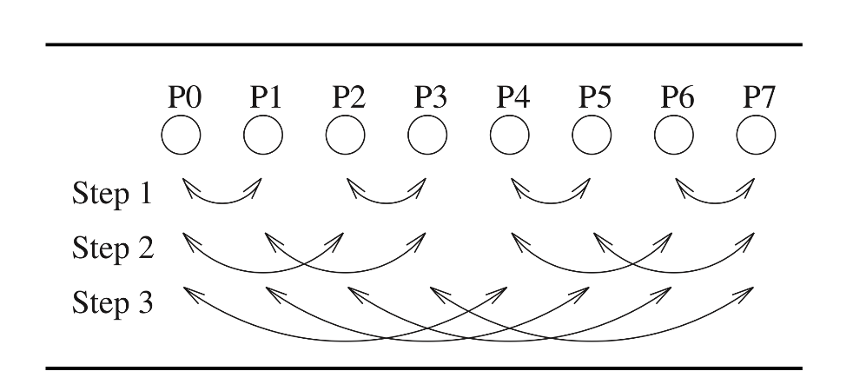
AllGather
Ring Algorithm
At time t: send the data you received at time t-1 to your right, and receive new data from your left.
At time 0, send your original data
Optimal bandwidth, high latency
T_{ring} = α (p-1) + β n (p-1)/p
α ：latency
β：time to transmit a byte
n: number of bytes of all processes
p: number of processes
Recursive Doubling Algorithm
At time t: process i exchanges (send/recv) all your current data (its original data plus anything received so far) with process i±2^{t}
Data exchanged at each step: n/p, 2n/p, 4n/p,…, 2^{lg(p)-1} n/p
Tricky for non-power-of-two
T_{rec-dbl} = α lg(p) + β n (p-1)/p

Slide 81
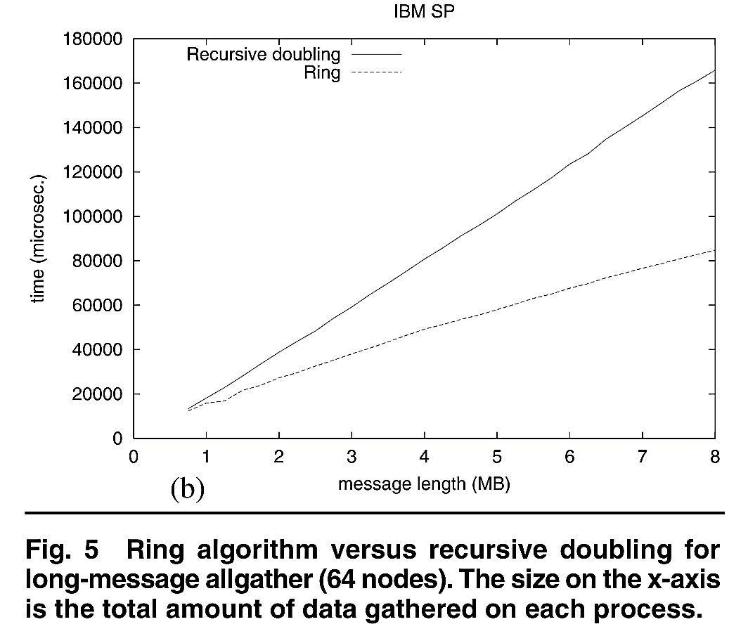
AllGather Performance
Similar ideas are used in other collectives (e.g. recursive halving instead of recursive doubling for reduce-scatter) with different local computations (e.g. for allreduce, perform a local reduction at each step instead of concatenating data as in allgather)
Thakur, Rajeev, Rolf Rabenseifner, and William Gropp. "Optimization of collective communication operations in MPICH." The International Journal of High Performance Computing Applications 19.1 (2005): 49-66

Slide 82

MPI Derived Datatype

Slide 83
Derived datatypes
Used to represent any collection of data items in memory by storing both the types of the items and their relative locations in memory.
The idea is that if a function that sends data knows this information about a collection of data items, it can collect the items from memory before they are sent.
Similarly, a function that receives data can distribute the items into their correct destinations in memory when they’re received.

Slide 84
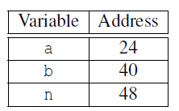
Derived datatypes
Formally, consists of a sequence of basic MPI data types together with a displacement for each of the data types.
Trapezoidal Rule example:

Slide 85
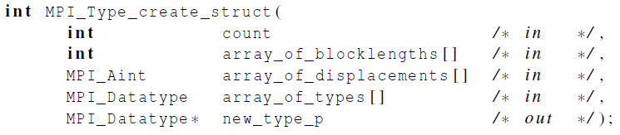
MPI_Type create_struct
Builds a derived datatype that consists of individual elements that have different basic types.

Slide 86
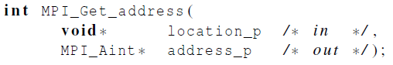
MPI_Get_address
Returns the address of the memory location referenced by location_p.
The special type MPI_Aint is an integer type that is big enough to store an address on the system.

Slide 87
MPI_Type_commit
Allows the MPI implementation to optimize its internal representation of the datatype for use in communication functions.

Slide 88
MPI_Type_free
When we’re finished with our new type, this frees any additional storage used.

Slide 89
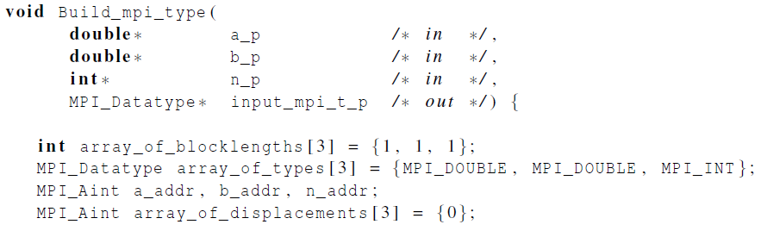
Get input function with a derived datatype (1)

Slide 90

Get input function with a derived datatype (2)

Slide 91

Get input function with a derived datatype (3)
MPI_Bcast
a
OS
buffer
b
n
Network interface

Slide 92
Difference with C Struct
struct range_integral_t {
double a;
double b;
int n;
};
a
struct range_integral_t* range_p
b
new or malloc
n
int main () {
double a;
……
double b;
int n;
};
a
int main () {
double a;
……
double b;
int n;
};
a
a
a
b
b
b
b
n
n
n
n
Buffer
Buffer
MPI_Type_create_struct
Send by Proc 0
MPI_Type_create_struct
Recv by Proc 1

Slide 93
Other derived datatype
MPI_Type_contiguous ( int count, MPI_Datatype datatype, MPI_Datatype *newtype );
count elements of the same datatype forming a contiguous chunk in the memory
Input datatype can be a derived datatype
End of one element of the derived datatype has to be exactly at the beginning of the next element of the derived datatype
int myvec[4];
MPI_Type_contiguous ( 4, MPI_INT, &mybrandnewdatatype);
MPI_Type_commit ( &mybrandnewdatatype );
MPI_Send ( myvec, 1, mybrandnewdatatype, … );

Slide 94

Other derived datatype
MPI_Type_vector( int count, int blocklength, int stride, MPI_Datatype datatype, MPI_Datatype *newtype );
count blocks of blocklength elements of the same datatype
Between the start of each block there are stride elements of the same datatype
double myvec[8];
dtype = MPI_DOUBLE; stride = 3;
blength = 2; count = 3;
MPI_Type_vector (count,blength,stride,dtype,&newtype);
MPI_Type_commit (&newtype);
MPI_Send ( myvec, 1, newtype, … );

Slide 95
Other derived datatype
MPI_Type_indexed( int count, int blocklengths[], int displacements[], MPI_Datatype datatype, MPI_Datatype *newtype );
The number of elements per block do not have to be identical
displacements gives the distance from the ‘base’ to the beginning of the block in multiples of the used datatype
count = 3
blocklengths[0] = 2 displacements[0] = 0
blocklengths[1] = 1 displacements[1] = 3
blocklengths[2] = 4 displacements[2] = 5

Slide 96
Other derived datatype
MPI_Type_create_subarray (int ndims, int sizes[], int subsizes[], int starts[], int order, MPI_Datatype datatype,MPI_Datatype *newtype);
Define sub-matrices of n-dimensional data
sizes[]: dimension of the entire matrix
subsizes[]: dimensions of the submatrix described by the derived data type
starts[]: array describing the beginning of the submatrices
Order: MPI_ORDER_C for row-major order or MPI_ORDER_FORTRAN for column-major data

Slide 97

Other derived datatype
ndims = 2;
sizes[0] = 8; sizes[1] = 8;
subsizes[0]= 4; subsizes[1] = 2
starts[0] = 2; starts[1] = 4;
MPI_Type_create_subarray ( ndims, sizes, subsizes, starts, MPI_ORDER_C,
MPI_DOUBLE, &newtype);

Slide 98
Problem of derived datatype
typedef struct {
char a;
int b;
double c;
float d;
} mystruct;
mystruct mydata[5];
mydata[0]
...... mydata[4]
If we just want to send elements b and c of the structure?

Slide 99
Problem of derived datatype
MPI_Get_address ( &(mydata[0], &baseaddr);
MPI_Get_address ( &(mydata[0].b, &addr1);
MPI_Get_address ( &(mydata[0].c, &addr2);
displ[0] = addr1 - baseaddr;
displ[1] = addr2 – baseaddr;
dtype[0] = MPI_INT; blength[0] = 1;
dtype[1] = MPI_DOUBLE; blength[1] = 1;
MPI_Type_create_struct (2,blength,displ,dtype,&newtype);
MPI_Type_commit ( &newtype);
MPI_Send ( mydata, 1, newtype,…); //it is ok if we send one struct instance.
MPI_Send ( mydata, 5, newtype, …); //If send more instances, received data will be wrong
Memory layout
What we send is
What we wanted to send is
...... mydata[4]

Slide 100
Problem of derived datatype
Solution to the problem
MPI_Type_create_resized ( MPI_Datatype datatype, MPI_Aint lb, MPI_Aint extent, MPI_Datatype *newtype );
Reset the low-bound and up-bound marker of a derived datatype
MPI_Get_address ( &(mydata[0]), &baseaddr);
MPI_Get_address ( &(mydata[0].b), &addr1);
MPI_Get_address ( &(mydata[0].c), &addr2);
MPI_Get_address ( &(mydata[1]), &addr3);
displ[0] = addr1 - baseaddr;
displ[1] = addr2 – baseaddr;
extent = addr3 – baseaddr;
dtype[0] = MPI_INT; blength[0] = 1;
dtype[1] = MPI_DOUBLE; blength[1] = 1;
MPI_Type_create_struct (4,blength,displ,dtype,&newtype);
MPI_Type_create_resized ( newtype, baseaddr, extent, &newtype2);
MPI_Type_commit ( &newtype2);

Slide 101

Performance evaluation

Slide 102


Elapsed parallel time
Returns the number of seconds that have elapsed since some time in the past.

Slide 103
Average/least/most execution time spent by individual process
int myrank, numprocs;
double mytime, maxtime, mintime, avgtime; /*variables used for gathering timing statistics*/
MPI_Comm_rank(MPI_COMM_WORLD, &myrank); MPI_Comm_size(MPI_COMM_WORLD, &numprocs);
MPI_Barrier(MPI_COMM_WORLD); /*synchronize all processes*/
mytime = MPI_Wtime(); /*get time just before work section */
work();
mytime = MPI_Wtime() - mytime; /*get time just after work section*/ /*compute max, min, and average timing statistics*/
MPI_Reduce(&mytime, &maxtime, 1, MPI_DOUBLE,MPI_MAX, 0, MPI_COMM_WORLD);
MPI_Reduce(&mytime, &mintime, 1, MPI_DOUBLE, MPI_MIN, 0,MPI_COMM_WORLD);
MPI_Reduce(&mytime, &avgtime, 1, MPI_DOUBLE, MPI_SUM, 0,MPI_COMM_WORLD);
if (myrank == 0) {
avgtime /= numprocs;
printf("Min: %lf Max: %lf Avg: %lf\n", mintime, maxtime,avgtime);
}
2.103

Slide 104


Elapsed serial time
In this case, you don’t need to link in the MPI libraries.
Returns time in microseconds elapsed from some point in the past.

Slide 105

Elapsed serial time

Slide 106

MPI_Barrier
Ensures that no process will return from calling it until every process in the communicator has started calling it.
Blocks until all processes in the group of the communicator comm call it.

Slide 107


MPI_Barrier

Slide 108

Run-times of serial and parallel matrix-vector multiplication
(Seconds)

Slide 109

Speedup

Slide 110

Efficiency

Slide 111

Speedups of Parallel Matrix-Vector Multiplication

Slide 112

Efficiencies of Parallel Matrix-Vector Multiplication

Slide 113

Scalability
A program is scalable if the problem size can be increased at a rate so that the efficiency doesn’t decrease as the number of processes increase.

Slide 114
Scalability
Programs that can maintain a constant efficiency without increasing the problem size are sometimes said to be strongly scalable.
Programs that can maintain a constant efficiency if the problem size increases at the same rate as the number of processes are sometimes said to be weakly scalable.

Slide 115
A parallel sorting algorithm

Slide 116
Sorting
n keys and p = number of processes.
n/p keys assigned to each process.
No restrictions on which keys are assigned to which processes.
When the algorithm terminates:
The keys assigned to each process should be sorted in (say) increasing order.
If 0 ≤ q < r < p, then each key assigned to process q should be less than or equal to every key assigned to process r.

Slide 117


Serial bubble sort

Slide 118


Odd-even transposition sort
A sequence of phases.
Even phases, compare swaps:
Odd phases, compare swaps:

Slide 119
Example
Start: 5, 9, 4, 3
Even phase: compare-swap (5,9) and (4,3) getting the list 5, 9, 3, 4
Odd phase: compare-swap (9,3) getting the list 5, 3, 9, 4
Even phase: compare-swap (5,3) and (9,4) getting the list 3, 5, 4, 9
Odd phase: compare-swap (5,4) getting the list 3, 4, 5, 9

Slide 120

Serial odd-even transposition sort

Slide 121
Communications among tasks in odd-even sort
Tasks determining a[i] are labeled with a[i].

Slide 122

Parallel odd-even transposition sort

Slide 123

Pseudo-code

Slide 124

Compute_partner

Slide 125
Safety in MPI programs
The MPI standard allows MPI_Send to behave in two different ways:
it can simply copy the message into an MPI managed buffer and return,
or it can block until the matching call to MPI_Recv starts.

Slide 126
Safety in MPI programs
Many implementations of MPI set a threshold at which the system switches from buffering to blocking.
Relatively small messages will be buffered by MPI_Send.
Larger messages, will cause it to block.

Slide 127
Safety in MPI programs
If the MPI_Send executed by each process blocks, no process will be able to start executing a call to MPI_Recv, and the program will hang or deadlock.
Each process is blocked waiting for an event that will never happen.

Slide 128
Safety in MPI programs
A program that relies on MPI provided buffering is said to be unsafe.
Such a program may run without problems for various sets of input, but it may hang or crash with other sets.

Slide 129
Sources of Deadlocks
Send a large message from process 0 to process 1
If there is insufficient storage at the destination, the send must wait for the user to provide the memory space (through a receive)
What happens with this code?
Process 0
Send(1)
Recv(1)
Process 1
Send(0)
Recv(0)
This is called “unsafe” because it depends on the availability of system buffers in which to store the data sent until it can be received

Slide 130
Some Solutions to the “unsafe” Problem
Order the operations more carefully:
Process 0
Send(1)
Recv(1)
Process 1
Recv(0)
Send(0)
Supply receive buffer at same time as send:
Process 0
Sendrecv(1)
Process 1
Sendrecv(0)

Slide 131
More Solutions to the “unsafe” Problem
Supply own space as buffer for send
Process 0
Bsend(1)
Recv(1)
Process 1
Bsend(0)
Recv(0)
Use non-blocking operations:
Process 0
Isend(1)
Irecv(1)
Waitall
Process 1
Isend(0)
Irecv(0)
Waitall

Slide 132


MPI_Ssend
An alternative to MPI_Send defined by the MPI standard.
The extra “s” stands for synchronous and MPI_Ssend is guaranteed to block until the matching receive starts.

Slide 133


Restructuring communication

Slide 134
MPI_Sendrecv
An alternative to scheduling the communications ourselves.
Carries out a blocking send and a receive in a single call.
The dest and the source can be the same or different.
Especially useful because MPI schedules the communications so that the program won’t hang or crash.

Slide 135


MPI_Sendrecv

Slide 136
Safe communication with five processes

Slide 137

Parallel odd-even transposition sort

Slide 138

Run-times of parallel odd-even sort
(times are in milliseconds)

Slide 139
MPI’s Non-blocking Operations
Non-blocking operations return (immediately) “request handles” that can be tested and waited on:
MPI_Request request;
MPI_Status status;
MPI_Isend(start, count, datatype, dest, tag, comm, &request);
MPI_Irecv(start, count, datatype, dest, tag, comm, &request);
MPI_Wait(&request, &status);
(each request must be Waited on)
One can also test without waiting:
MPI_Test(&request, &flag, &status);
Accessing the data buffer without waiting is undefined

Slide 140
MPI’s Non-blocking Operations
It is sometimes desirable to wait on multiple requests:
MPI_Waitall(count, array_of_requests, array_of_statuses)
MPI_Waitany(count, array_of_requests, &index, &status)
MPI_Waitsome(count, array_of_requests, array_of indices, array_of_statuses)
There are corresponding versions of test for each of these.

Slide 141
Concluding Remarks (1)
MPI or the Message-Passing Interface is a library of functions that can be called from C, C++, or Fortran programs.
A communicator is a collection of processes that can send messages to each other.
Many parallel programs use the single-program multiple data or SPMD approach.

Slide 142
Concluding Remarks (2)
Most serial programs are deterministic: if we run the same program with the same input we’ll get the same output.
Parallel programs often don’t possess this property.
Collective communications involve all the processes in a communicator.

Slide 143
Concluding Remarks (3)
When we time parallel programs, we’re usually interested in elapsed time or “wall clock time”.
Speedup is the ratio of the serial run-time to the parallel run-time.
Efficiency is the speedup divided by the number of parallel processes.

Slide 144
Concluding Remarks (4)
If it’s possible to increase the problem size (n) so that the efficiency doesn’t decrease as p is increased, a parallel program is said to be scalable.
An MPI program is unsafe if its correct behavior depends on the fact that MPI_Send is buffering its input.

